Slide 1

Indiana Soccer Referees Association UI Transformation
Team 19

Slide 2


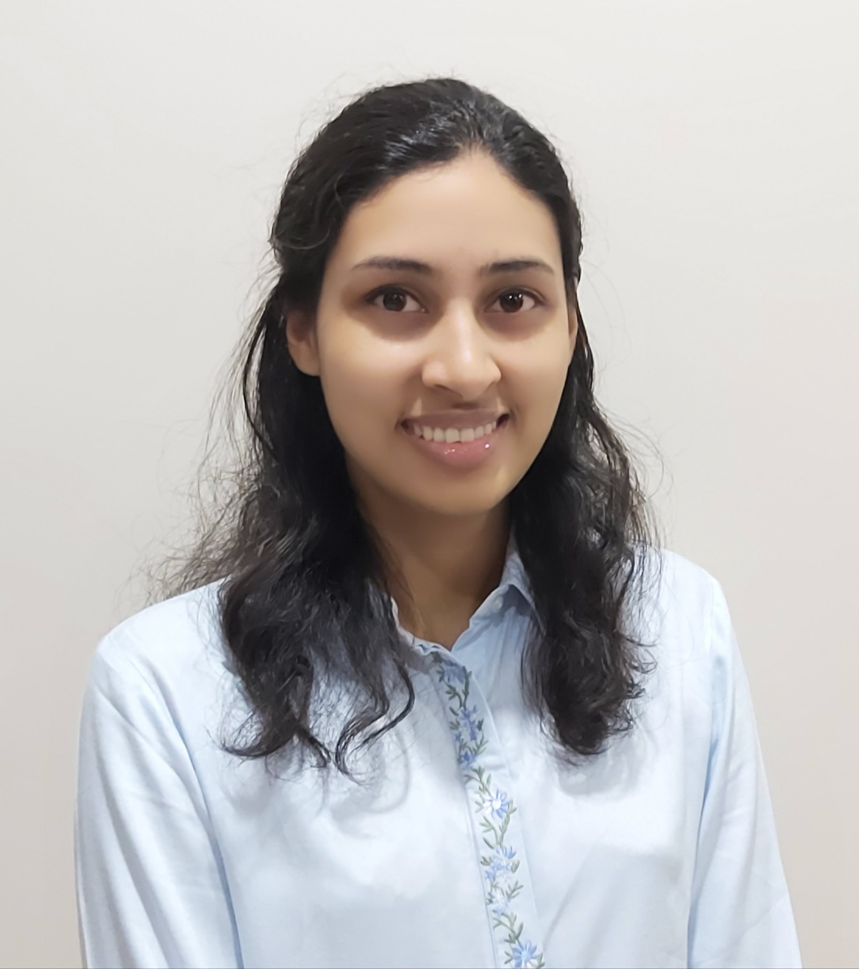

Team 19
Jake Joseph
jakejose@iu.edu
Lead App Developer
JJ Bogner
jjbogner@iu.edu
Cloud Architect
Priya Huddar
phuddar@iu.edu
Data Engineer
Vivi Armacost
varmacos@iu.edu
UI Designer

Slide 3
Presentation Agenda
Business Case
Scope, Time and Resources
Application Demo
Technology Stack
Design Steps
User Stories
Risks & Mitigations
Data Model
Future Steps

Slide 4
Tracking the assignment and status of referees is a full-time job at ISRA
Indiana Soccer Referees Association is responsible for assigning referees to USSF sanctioned club matches in the greater Indianapolis area
Tracking the assignment and status of referees manually is a full-time job
How can we design a custom application for ISRA where employees can manage referee and game information?
Introduction
Design Process
4
Demonstration
Lessons Learned
Conclusion

Slide 5
The custom application will allow seamless referee management
The application has three major functionalities
Data Entry
User can view a list of referees with their basic information. Referee records may be added, edited or deleted
Detail View with related list
User may view referee detail showing past, present and future referee games
Reports
User may download custom reports of games assigned to user within a date range and future games with unassigned positions
Introduction
Design Process
5
Demonstration
Lessons Learned
Conclusion

Slide 6
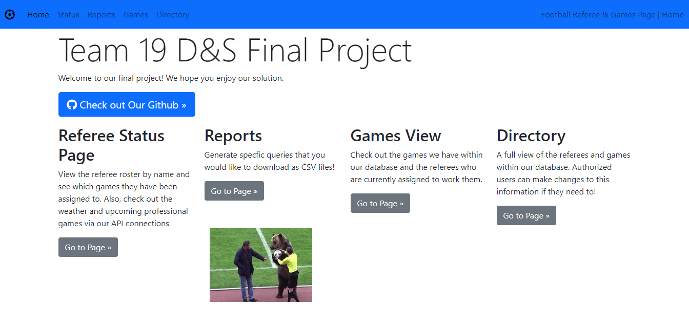
Application Demonstration
D&S Website
Introduction
Design Process
6
Demonstration
Lessons Learned
Conclusion

Slide 7
With a vision to open-source the application to help other associations, our chosen Technology stack meets all needs
PHP
Lightweight, open source, easy to use framework; employs high-decoupling
MySQL
Open source, reliable, compatible with all major hosting providers, cost-effective, and easy to manage
Amazon EC2
Eliminate need for investing in hardware for hosting, reliable, scalable, secure
Vue.js
Open source, extensive community support, widely used
Bootstrap
Readily available templates for design of webpages
Apache WebServer
Web servers are easy to customize environments, they're fast, reliable, and highly secure
Introduction
Design Process
7
Demonstration
Lessons Learned
Conclusion

Slide 8
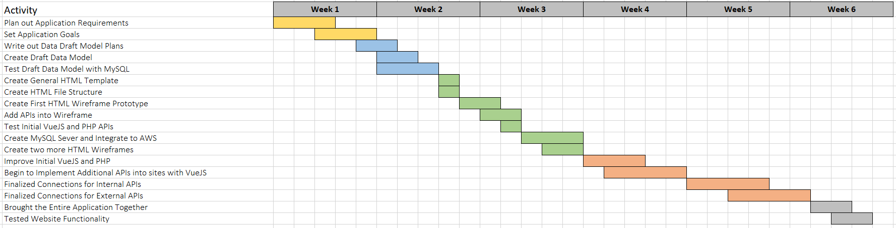
Timeline
Introduction
Design Process
8
Demonstration
Lessons Learned
Conclusion
Notes:
Should this stay looking like this

Slide 9
Financials
Number of Developers/Designers 4
Estimated number of hours 30 days x 1hr/day x #of devs = 120 hr
Average hourly wage $40/hr
Software Development cost $40/hr. x 120 hrs = $4800
Introduction
Design Process
9
Demonstration
Lessons Learned
Conclusion

Slide 10




Vision for the future...
Add Data Validation for all input fields
Login and authentication for user access
Implementing security layers into application
Open-sourcing of project with community development and maintenance
Estimated Costs- Development Costs - $40 x 300hrs = $12000
Introduction
Design Process
10
Demonstration
Lessons Learned
Conclusion

Slide 11















Design Process
1. Understand situation and requirement evaluation
Attend discovery meetings to understand the problem at hand
and decide how we will choose a solution
Automize and Pivot Sales
7. Testing and Final Push
2. Timeline Prospective
Test website features using internal and external
actors before final push
Decide upon timeline for project completion to
accommodate set deadlines
6. Website Widget Integration
User Stories
Integrate JavaScript and PHP information
into website
and consuming data
Design user stories and acceptance criteria
5. Content Creation
Website Shell
Write material that meets acceptance criteria and
reaches scope of situation
Create ghost website for a starting off point
Introduction
Design Process
11
Demonstration
Lessons Learned
Conclusion

Slide 12
Overview of Lessons Learned through the Application Development Process
Team Dynamics
Communication
Microsoft Teams channel, in person meetings
Effectiveness
Separation of tasks, divide and conquer
Jake- Lead App Developer
Smooth collaboration utilizing standard communication technologies and responsibility allocation
JJ- Cloud Architect
Priya- Data Engineer
Vivi- UI designer
Responsibilities
Introduction
12
Demonstration
Design Process
Lessons Learned
12
Conclusion

Slide 13
Lessons Learned – Jake Joseph
Building in debugging mechanisms will help locate errors efficiently
File structure is key to communication between the different features of the application
Setting up an MVP to test in the cloud will allow the team to fix cloud synergy issues before the deadline
Creating a plan and goals before starting the actual programming is key to decreasing the amount of unusable code
Jake Joseph
jakejose@iu.edu
Lead App Developer
Design Process
Data Model
13
Solution
Risks & Mitigations
Future Steps
Introduction
Introduction
Design Process
13
Demonstration
Lessons Learned
Conclusion

Slide 14
Lessons Learned – JJ Bogner
There are a lot of different ways to do something - googling can quickly show different applicable methods available.
Do not be afraid to ask your team for help when you have issues
Start early
Small errors can be huge complications – copy & paste code whenever possible instead of typing.
Double-check everything that has been manually typed before moving on to next step
JJ Bogner
jjbogner@iu.edu
Cloud Architect
Design Process
Data Model
14
Solution
Risks & Mitigations
Future Steps
Introduction
Introduction
Design Process
14
Demonstration
Lessons Learned
Conclusion

Slide 15
Lessons Learned – Priya Huddar
Importance of writing clean code that is understood by all team members
Learning to look for and describe errors to teammates
Most errors that we come across have already been resolved by others – Google, look into Teams channel for classmates' insights
Importance of communication and playing to the strengths of all team members
Priya Huddar
phuddar@iu.edu
Data Engineer
Design Process
Data Model
15
Solution
Risks & Mitigations
Future Steps
Introduction
Introduction
Design Process
15
Demonstration
Lessons Learned
Conclusion

Slide 16
Lessons Learned – Vivi Armacost
Collaborative Programming
Navigating opposing design perspectives within a team
Virtually collaborating on code utilizing GitHub and Docker
Over communicate at all points, especially when not working in person
Ask for another pair of eyes when you cannot find a bug in your code
Vivi Armacost
varmacos@iu.edu
UI Designer
Design Process
Data Model
16
Solution
Risks & Mitigations
Future Steps
Introduction
Introduction
Design Process
16
Demonstration
Lessons Learned
Conclusion

Slide 17
Appendix
User Story
Risks and Mitigations Expanded
Data Model

Slide 18
User Stories that guided our development
User Story | Acceptance Criteria
As a user, I want to view a list of referees with their basic information | Webpage displays a table with referee name. User can click on a particular name to view details- name, age, referee grade, skill level
As a user I assign a particular referee to a game | User is able to select referee and enter the game to be assigned. The data is updated in the table
As a user, I want to download reports that show all games assigned to referees in a given date range | User can select start and end dates from a calendar. A .csv report can be downloaded including games assigned in the date range

Slide 19
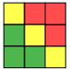
Risks and Mitigation
Risk | Risk Profile | Mitigation
The application does not have security layers. It is prone to common external attacks such as SQL injection. |  | In the future development phases, we plan to incorporate a robust security upgrade to the site.
We are using public APIs for viewing weather information which have a risk of going down / out of service. |  | In the future we plan to develop a API monitoring process and identify alternative public APIs in the case that one of our current APIs is down for an extended period of time.
Our current application requires a manual process for updating the server after we make changes to the original repository. |  | In future application updates, we will create an automatic process for pulling data from GitHub to our server.
Probability
X
Impact
Probability
X
Impact
Probability
X
Impact

Slide 20
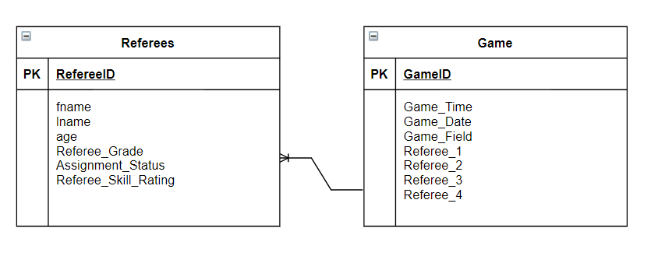
Data Model
Database Structure- ER Diagram

